Slide 1



Custom Software Development
April 20, 2023

Slide 2



















WHY TEVPRO?
Founded to embody the principles of Truth, Expertise, Value
Highly-technical consultants with Enterprise, Mobile, and Web software expertise
Proven success taking Fortune 500, public, and SaaS solutions from vision to reality
Highest quality implementation model, focused on project ROI and time-to-market
Microsoft partner with white-glove service throughout all client engagements
25+ customers, 100% customer success

Slide 3
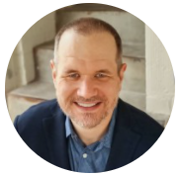



OUR LEADERSHIP TEAM
KEITH KIKTA
OWNER & TECHNOLOGY PRINCIPAL
Lifelong technologist, polyglot architect/developer
Deep experience with backend architecture, data integrations and infrastructure management
Specializes in high volume data ETL and custom process automation
JUSTIN WALDRIP
OWNER & TECHNOLOGY PRINCIPAL
25 years experience in technology, development, architecture
Creator and chief developer on largest SaaS visitor management platform in US.
Specializes in cross-platform solutions, architecture to scale, and intuitive UIs
ERIK WEST
OWNER & CPM/EPM PRINCIPAL
Experienced with CPM/EPM platforms, esp. OneStream and Oracle EPM/Hyperion
Background in custom software development and custom reporting
Specializes in budgeting/ forecasting, driver based calculations, complex data integrations and multi-step allocations

Slide 4
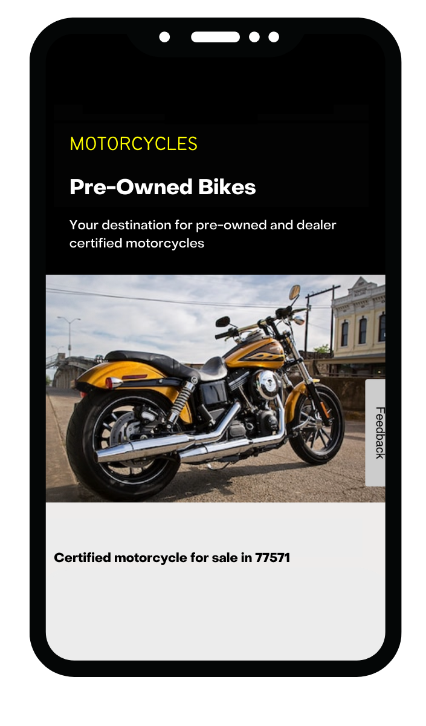

ECOMMERCE MARKETPLACE
When America's most loved motorcycle brand wanted to connect bike inventories from over 700 franchise dealerships into one single Marketplace, they turned to Tevpro for help.
DATA INTEGRATIONS:
We engineered sophisticated data integrations to connect disparate inventories into one cohesive platform.
TECHNOLOGIES USED:
Azure Service Bus, Kubernetes, Redis, and MongoDB.
BENEFITS DELIVERED:
Seamless integration of disparate data sources from motorcycle dealerships across the nation.
Real-time updates to inventory and price changes.
Dramatic ROI from the first of it’s kind pre-owned Certified motorcycle marketplace.
CUSTOM SOFTWARE DEVELOPMENT

Slide 5

FIELD MOBILITY SOLUTIONS
Tevpro built a native mobile application to leverage real-time field data, increase field worker efficiency, and reduce the operational cost of maintaining a 24-hour call center.
DATA INTEGRATIONS
We engineered sophisticated custom process to extract data from vast oilfield sensor networks and SCADA systems and provided real-time access to analyze this data in Microsoft Azure cloud.
TECHNOLOGIES USED
Angular, Ionic Framework, and C# .NET
BENEFITS DELIVERED:
Real-time alerts, access to analyze field data, and immediate technician dispatch.
Improves productivity and efficiency of field technicians.
Reduce reliance on call center administrative processes and minimizing operational downtime.
CUSTOM SOFTWARE DEVELOPMENT

Slide 6
KEY METRICS OF SUCCESS
Our goal is 100% customer success.
Every client, every time.
The right size, the right team - the right Technology partner
Our company leadership is technical and hands-on
Dedicated Team - full focus on your success
Tevpro’s motivation: creating elegant, quality solutions that add value & solve problems
Better value with better results

Slide 7


PROJECT SCOPE

Slide 8

PROJECT SCOPE - BILL TRACKING MVP
Mock UI Flow (mobile and desktop)
Login
User Management
Bill Search
Bill View
Staff Contact Tool
Setup PWA Framework
Build Authentication and User Mgmt
Auth
Profile Management
Roles and Feature flags
Document Ingestion
Scrapers/Crawlers to ingest and collect data
Document Processing
Document Storage
Search
Search Interface
Tracker
Timeline (8-10 Months)
Design
Architecture
Testing
Deployment
Dedicated Development Resources
Front-end FTE
Back-end FTE
Project Manager
Partner, Principle
Estimate Hours - 2,560 hours
Development Cost - $350k
*This is a time and materials estimate based on information known to date. Tevpro always looks for how to leverage existing solutions to accelerate development time.
Notes:
UAT

Slide 9
SAMPLE PROJECT TIMELINE
Month | June/July |  |  |  | August |  |  |  |  | Sept/Nov |  |  | Dec |  |  |  |  | January |  |  |  | February |  |  |  | March
Week # | 1 | 2 | 3 | 4 | 5 | 6 | 7 | 8 | 9 | 10 | 11 | 12 | 13 | 14 | 15 | 16 | 17 | 18 | 19 | 20 | 21 | 22 | 23 | 24 | 25 | 26 | 27 | 28 | 29
Week starting | 12/6 | 12/13 | 12/20 | 12/27 | 1/3 | 1/10 | 1/17 | 1/24 | 1/31 | 2/7 | 2/14 | 2/21 | 2/28 | 3/7 | 3/14 | 3/21 | 3/28 | 4/4 | 4/11 | 4/18 | 4/25 | 5/2 | 5/9 | 5/16 | 5/23 | 5/30 | 6/6 | 6/13 | 6/20
Project Prep
Req & Design
Set up PWA Framework
Build Authentication and User Mgmt
Data Ingestion
Core Build
User Acceptance/Beta Testing
Cut-Over
Parallel Support |  |  |  |  |  |  |  |  |  |  |  |  |  |  |  |  |  | Part Time
Go Live Support |  |  |  |  |  |  |  |  |  |  |  |  |  |  |  |  |  |  |  |  |  | Part Time
This tentative timeline will be revised by the project team following detailed requirements and design meetings.

Slide 10
NEXT STEPS
Requirements gathering/design meetings
Draft detailed MVP/Scope
Finalize agreements (SOW)

